Slide 1
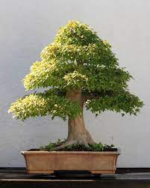
A Work of Artifice
By
Marge Piercy

Slide 2
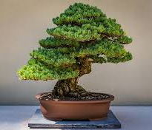
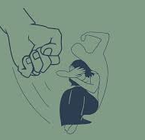
Theme of the poem and use of allegory (symbol)
Theme deals with social limitations of a woman and the oppression of women in a patriarchal society.
The poet uses the bonsai tree as a symbol or allegory of women. Just as a bonsai tree is not allowed to grow, so also society and ancient customs dwarf the growth of women.
Throughout the poem the bonsai tree is an extended metaphor for a women.

Slide 3
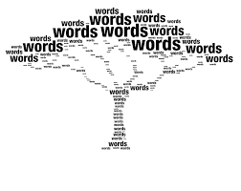
Form and tone of the poem…..
The poem is written in free verse i.e. it has no consistent rhyme, stanza or musical form.
24 - line poem
The lines run onto each other with short sentences to convey the urgency of the message
Uses a sarcastic tone to show the contrast between the natural and the tamed

Slide 4
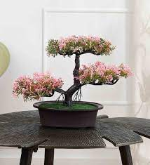

Title: A Work of Artifice
Artifice means an act of clever and deliberate deception
Generally, a bonsai tree is looked upon as an art or craft of skill associated with creativity. Here the poet makes it appear as if the gardener has tricked the tree into stunting its growth to fit into a pot and decorate a living room. Women too, like the bonsai are made to fit social norms with their growth being repressed deceptively.
The poet too deceives the reader into thinking at first that the poem is about a bonsai tree – till she reveals the real theme of the poem.

Slide 5
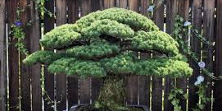
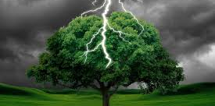
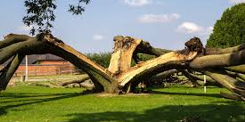
The poem…..
The bonsai tree in an attractive pot could have grown wildly by the mountain side
Lightning could have rivetted the tree during storm
The tree then would have fought nature to survive on its own

Slide 6
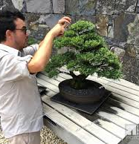
The gardener’s work
But: shows the contrasting fate of the tree….
Juxtaposing image of a tiny ornamental tree in a pot secure in a domestic space
The gardener cut it “carefully” to keep it to the desired height of nine inches
Reducing the branches everyday and singing to it..

Slide 7
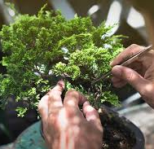
The Gardener croons….
Tells the bonsai that it is the nature of the bonsai to be small and cozy and being domesticated.
Since it is weak it needs to be protected.
He also tells the bonsai that it is lucky to have a ‘pot’ to grow in i.e lucky to have a home to be protected from ‘lightnings’

Slide 8
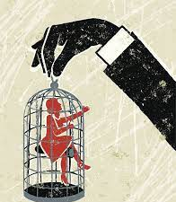
Shift from bonsai to women….
Reader becomes aware the poem is about women when the poet says:
“with living creatures, one must begin early to dwarf their growth….”

Slide 9
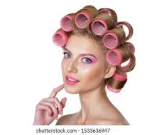

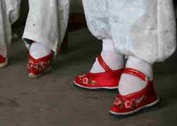
What the gardener does….
Dwarfs the growth from a “very early” stage
Binds the feet – to keep the feet small and attractive (symbolic of limiting their freedom)
Cripples their brain not to think independently
Hair in curlers to look pretty (one of the roles of a women)

Slide 10

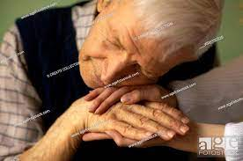
Concluding two lines…
Ironical – after oppressing the women to fit a stereotyped role, he still seeks the comfort and the loving touch of the woman he repressed.
It indicates that in spite of the work of artifice that the gardener has practiced on her, she is still her own person whom he needs to go to for reassurance and comfort.

Slide 11

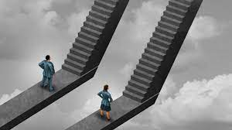
The symbols used in the poem
Bonsai tree - symbolic of a repressed woman
Attractive Pot – a home to call her own(attractive because it’s a trap)
Gardener – the patriarch or the male member of society who wants women to fit into a particular role
Mountain and lightning – the larger world and the dangers and opportunities that women would face

